Slide 1
CLASS & OBJECT
Shekh. Md. Saifur Rahman
Lecturer, Department of CSE,
United International University
Email id : saifur@cse.uiu.ac.bd
Acknowledged: Tanjina Helaly

Slide 2
CONTENT
Overview of Object Oriented Programming (OOP)
Class & Object.
Initializing Fields/Instance variables.
Scope & Lifetime of Variable.
Arrays
Parameter Passing
Garbage Collection
Package
Access Modifier
Recursion
Variable Argument - vararg

Slide 3
TWO PARADIGMS IN OOP
All computer programs consist of two elements:
code and data.
A program can be conceptually organized around its code or around its data.
That is, some programs are written around “what is happening” and others are written around “who is being affected.”
These are the two paradigms that govern how an OOP program is constructed.
In Procedural language data and operation/code are separate
Example (using C)
Student – 4 fields: name, id, cgpa, creditCompleted
Update cgpa – need a function to calculate the new cgpa

Slide 4
Procedural Programming
Procedural Programs:
Split a program into tasks and subtasks
Write functions to carry out the tasks
Instruct the computer to execute the functions in a sequence
Problems:
Large amount of data and intricate flow of tasks: complex and unmaintainable
More importance to algorithms & functions than data being used by the functions
Multi-function programs – shared data items are placed as global
Changes in data structure affect functions and involve rewriting code

Slide 5
Object Oriented Programming
Concise
Maintainable (Cause it’s Object Oriented)
Portable (supports nearly any processor)
OOP treats data as a critical element in the program development
Does not allow data to flow freely around the system.
Package data and code as objects
Programs model the problem using abstract objects and interactions between them. E.g., Complex numbers (x + yi)

Slide 6
Object Oriented Programming
It is possible to map objects in the problem domain to those objects in the program
Data hiding helps the programmer to build secure programs that cannot be invaded by code in other parts of the program
Through inheritance, we can eliminate the redundant code and extend the use of existing code
It is possible to have multiple instances of an object to co-exist without any interference.
Easy to partition the work in a project based on objects.

Slide 7
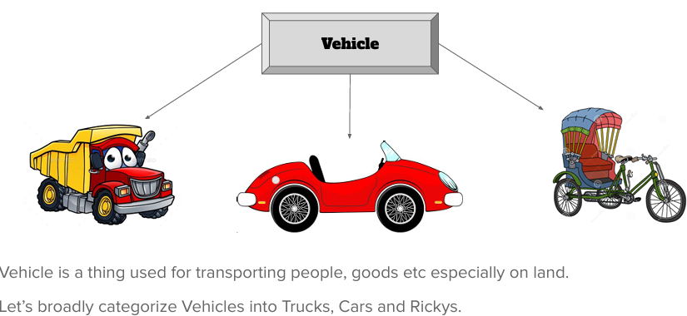
Concept: Class

Slide 8
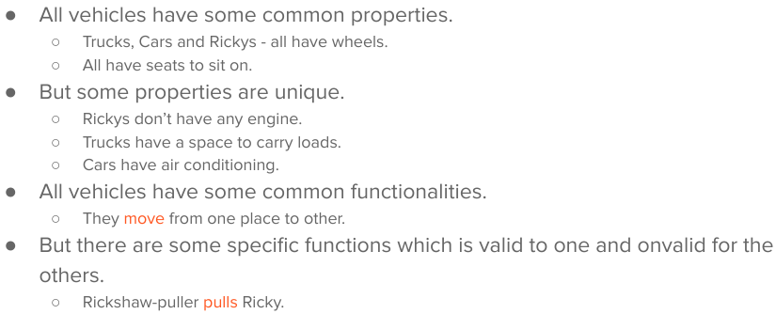
Concept: Class

Slide 9
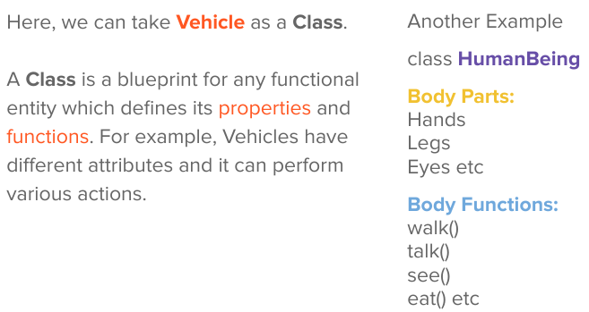
Concept: Class

Slide 10
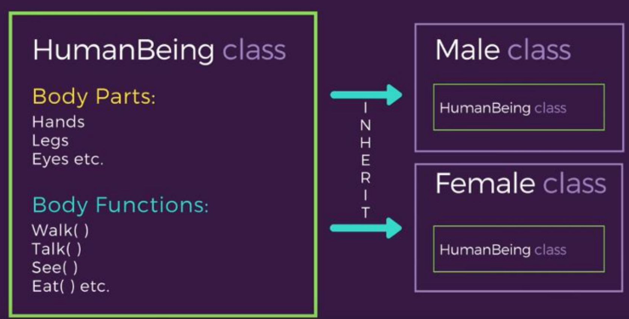
Concept: Object

Slide 11
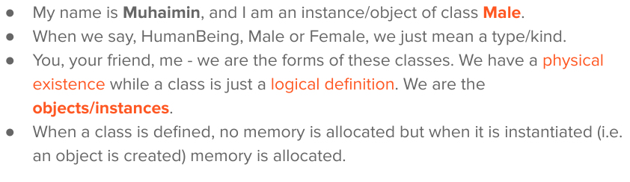
Concept: Object

Slide 12
CLASS & OBJECT
Object
An object is a software bundle of related state and behavior.
Software objects are often used to model the real- world objects that you find in everyday life.
Class
A class is a blueprint or prototype from which
objects are created.
It defines what should be in each object and how
each object should behave.

Slide 13
WHAT IS CLASS
The class is the basis for object-oriented
programming in Java.
It defines a new data type.
Once defined, this new type can be used to create objects of that type.
Thus, a class is a template for an object,
and an object is an instance of a class.
Because an object is an instance of a class, you will often see the two words object and instance used interchangeably

Slide 14
CLASS MEMBERS
Class contains the following 2 members
instance variables(fields/properties/attributes)
Each instance of the class (that is, each object of the class) contains its own copy of these variables.
Thus, the data for one object is separate and unique from
the data for another.
Methods(action/behavior)
The code is contained within methods
In most classes, the instance variables are acted upon and accessed by the methods defined for that class.
Thus, as a general rule, it is the methods that determine how a class’ data can be used.

Slide 15
THE GENERAL FORM OF A CLASS
class classname {
datatype instance-variable1; datatype instance-variable2;
// ...
datatype instance-variableN;
retyrntype methodname1(parameter-list) {
// body of method
}
returntype methodname2(parameter-list) {
// body of method
}
// ...
returntype methodnameN(parameter-list) {
// body of method
}
}

Slide 16
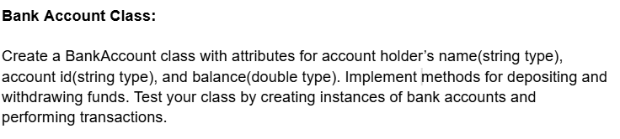
Class Example

Slide 17
A SIMPLE CLASS
public class BankAccount {
// Instance variables public String name; public String id; public double balance;
// Methods
public void deposit(double amount){
balance = balance + amount;
}
public void withdraw(double amount){ if (amount<balance)
balance -= amount;
}
}

Slide 18
CREATE OBJECT AND ACCESS MEMBERS
Creating objects – use new keyword
ClassName refVariable = new ClassName(parameter-list);
To access instance variables and methods - use
dot operator(.)
Accessing instance variables
refVariable.instance_variable = value;
Or
datatype value = refVariable.instance_variable;
Calling methods
refVariable.methodName(parameter-list);

Slide 19
CREATE OBJECT AND ACCESS MEMBERS
public class TestBankAccount {
public static void main(String[] args) {
// Creating objects
BankAccount account = new BankAccount();
// Assigning values to instance variables
account.name = "Rashid";
account.id = “1000500”;
account.balance = 1000;
// Print balance
System.out.println(“Balance before deposit: " + account.balance);
// Calling methods
account.deposit(2000);
// Print balance
System.out.println(“Balance after deposit: " + account.balance);
}
}
Output:
Balance before deposit: 1000.0 Balance after deposit: 3000.0

Slide 20
CREATE OBJECT AND ACCESS MEMBERS
public class TestBankAccount {
public static void main(String[] args) {
Use “new” keyword to create object
// Creating objects
BankAccount account = new BankAccount();
// Assigning values to instance variables
account.name = "Rashid";
account.id = “1000500”;
account.balance = 1000;
Use “dot operator” (.) to access
attributes and methods.
// Print balance
System.out.println(“Balance before deposit: " + account.balance);
// Calling methods
account.deposit(2000);
// Print balance
System.out.println(“Balance after deposit: " + account.balance);
}
}
Output:
Balance before deposit: 1000.0 Balance after deposit: 3000.0

Slide 21
REFERENCE VARIABLE
BankAccount account;
account
account = new BankAccount();
account
reference
name = null
id = null
balance = 0.0
account.name = “Rashid”; account.id = “1000500”;
account.balance = 1000;
account
reference
name = Rashid
id = 1000500
balance = 1000

Slide 22
CREATE OBJECT AND ACCESS MEMBERS
public class TestBankAccount {
public static void main(String[] args) {
// Creating objects
BankAccount accountR = new BankAccount();
BankAccount accountK = new BankAccount();
// Assigning values to instance variables accountR.name = "Rashid"; accountR.balance = 1000;
accountK.name = "Kashem"; accountK.balance = 1000;
// Calling methods
accountK.deposit(2000);
// Print balance of both account
System.out.println("Kashem's balance: " + accountK.balance);
System.out.println("Rashid's balance: " + accountR.balance);
}
}
Output:
Kashem's balance: 3000.0
Rashid's balance: 1000.0

Slide 23
REFERENCE VARIABLE
Before deposit
accountR
reference
name = Rashid
id = null
balance = 1000.0
name = Kashem
id = null
accountK
reference
balance = 1000.0
After deposit:
accountR
reference
name = Rashid id = null
balance = 1000.0
reference
name = Kashem id = null
accountK
balance = 3000.0

Slide 24
INITIALIZING FIELDS/INSTANCE
VARIABLES

Slide 25
INITIALIZING FIELDS
There are three ways in Java to give a field an
initial value:
Direct Assignment
Instance Initialization Block
Constructors

Slide 26
1.DIRECT ASSIGNMENT
public class BankAccount {
// Instance variables public String name; public String id;
public double balance = 100.0; // direct assignment
// Methods
public void deposit(double amount){
balance = balance + amount;
}
public void withdraw(double amount){ if (amount<balance)
balance -= amount;
}
}

Slide 27
2.INSTANCE INITIALIZATION BLOCK
Instance initialization blocks are indicated by blocks
of code inside the class, but outside any method.
Whenever an object is created from a class, the code in
each instance initialization block is executed.
If there is more than one instance initialization block, they are executed in order, from top to bottom of the class.
Direct assignment and constructors are used far more often than initialization blocks.

Slide 28
2.INSTANCE INITIALIZATION BLOCK
public class BankAccount {
// Instance variables public String name; public String id; public double balance;
// Methods
public void deposit(double amount){
balance = balance + amount;
}
public void withdraw(double amount){ if (amount<balance)
balance -= amount;
}
{ // Instance Initialization Block
id = “011”
balance = 100.0;
}
}

Slide 29
3.CONSTRUCTOR
A Constructor is a special member function
Same name as its class
No return type, not even void
This is because the implicit return type of a class’ constructor is the class type itself.
It has to be public
Invoked implicitly when instance/object is created
Can be overloaded
Are called in the order of creation
A constructor used to
Allocate space for instance variables.
initializes an object(its instance variables) immediately upon creation.

Slide 30
3.CONSTRUCTOR
What should go inside Constructor
Normally the instance variables are initialized inside the constructor.
Or
any set-up code
Types of Constructor
Default constructor/zero-arg constructor
Parameterized constructor
If a constructor with parameters is defined, then the default constructor is not available. Either one has to use a zero-arg constructor or use default args with the parameterized constructor.

Slide 31
3.CONSTRUCTOR - EXAMPLE
import java.util.Random; public class BankAccount {
// Instance variables public String name; public String id; public double balance;
// Constructor without parameter
public BankAccount(){
id = new Random().nextInt(99999) + "";
// name and balance will get default value
}
// Constructor with parameter
public BankAccount(String _name, String _id, double _balance){
name = _name; id = _id;
balance = _balance;
}
public static void main(String[] args)
{
BankAccount ba = new BankAccount(“Rashid”, “1000500”, 1000.0);
}
}

Slide 32
3.DEFAULT CONSTRUCTOR
When you do not explicitly define a constructor for a class,
then Java creates a default constructor for the class.
This is why the first BankAccount class code worked even though that did not define a constructor.
The default constructor automatically initializes all instance variables to their default values,
Default value
Boolean -> false;
All primitive except boolean -> 0 (zero)
Reference type -> null
Once you define your own constructor, the default
constructor is no longer used.

Slide 33
“THIS”KEYWORD
refer to the current object.
That is, this is always a reference to the object on which the method was invoked.
You can use this anywhere a reference to an object of the current class’ type is permitted.

Slide 34
CONSTRUCTOR - EXAMPLE
import java.util.Random; public class BankAccount {
// Instance variables public String name; public String id; public double balance;
// Constructor without parameter
public BankAccount(){
id = new Random().nextInt(99999) + "";
// name and balance will get default value
}
// Constructor with parameter
public BankAccount(String _name, String _id, double _balance){
name = _name; id = _id;
balance = _balance;
}
public static void main(String[] args)
{
BankAccount ba = new BankAccount(“Rashid”, “1000500”, 1000.0);
}
}

Slide 35
CONSTRUCTOR - EXAMPLE
import java.util.Random; public class BankAccount {
// Instance variables public String name; public String id; public double balance;
// Constructor without parameter
public BankAccount(){
id = new Random().nextInt(99999) + "";
// name and balance will get default value
}
// Constructor with parameter
public BankAccount(String name, String id, double balance){
name = name; id = id;
balance = balance;
}
public static void main(String[] args)
{
BankAccount ba = new BankAccount(“Rashid”, “1000500”, 1000.0);
}
}

Slide 36
CONSTRUCTOR - EXAMPLE
import java.util.Random; public class BankAccount {
// Instance variables
public String name; public String id; public double balance;
// Constructor without parameter
public BankAccount(){
id = new Random().nextInt(99999) + "";
// name and balance will get default value
}
// Constructor with parameter
public BankAccount
(String name, String id, double balance)
{
name = name;
id = id;
balance = balance;
Variable on left is the same as right What are we doing here
Which variables we are referring to
}
public static void main(String[] args)
{
BankAccount ba = new BankAccount(“Rashid”, “1000500”, 1000.0);
}
}

Slide 37
CONSTRUCTOR - EXAMPLE
import java.util.Random; public class BankAccount {
// Instance variables public String name; public String id; public double balance;
// Constructor without parameter
public BankAccount(){
id = new Random().nextInt(99999) + "";
// name and balance will get default value
}
// Constructor with parameter
public BankAccount(String name, String id, double balance){ this.name = name;
this.id = id;
this.balance = balance;
}
public static void main(String[] args)
{
BankAccount ba = new BankAccount(“Rashid”, “1000500”, 1000.0);
}
}

Slide 38
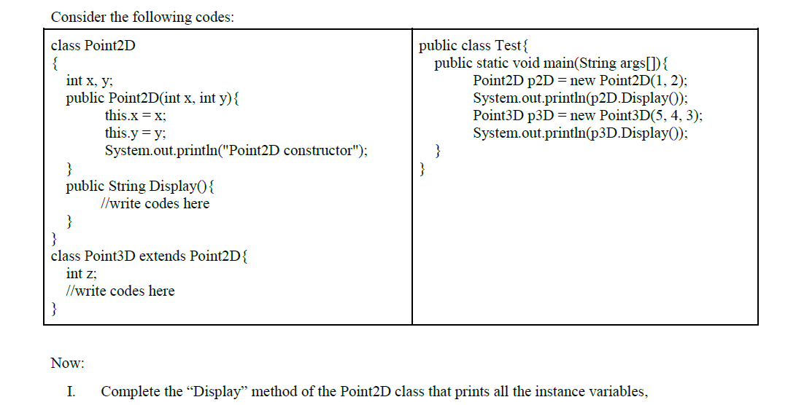
Spring 2024 Question 1

Slide 39
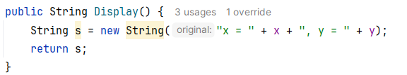
Spring 2024 Question 1

Slide 40
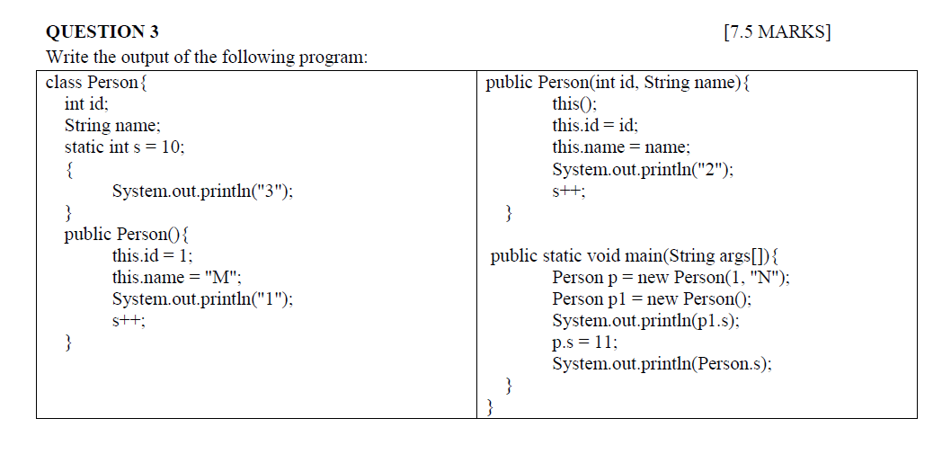
Spring 2024 Question 3

Slide 41

Spring 2024 Question 3
Output

Slide 42
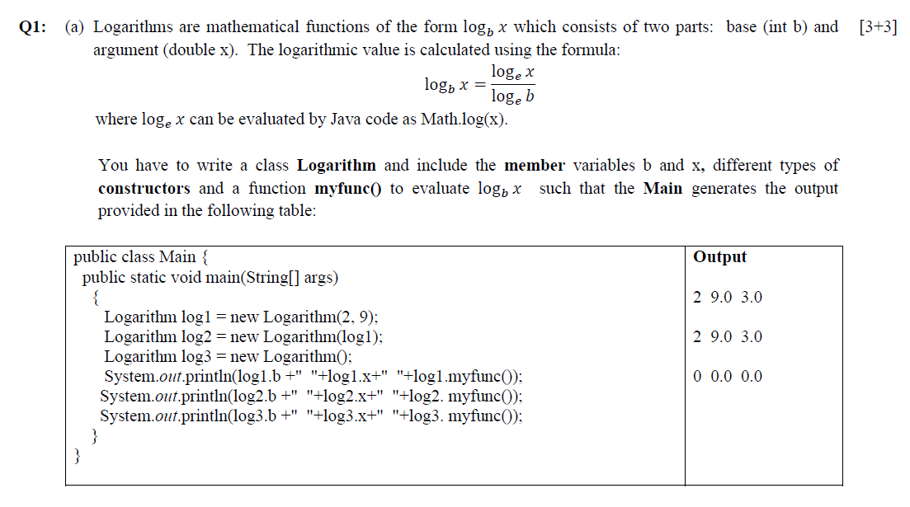
Fall 2023 Question 1

Slide 43
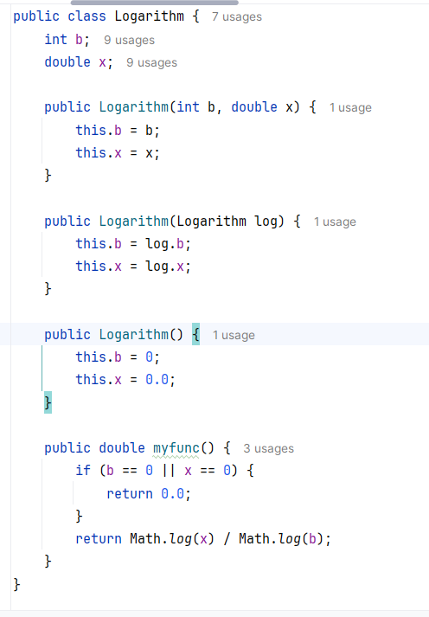

Slide 44
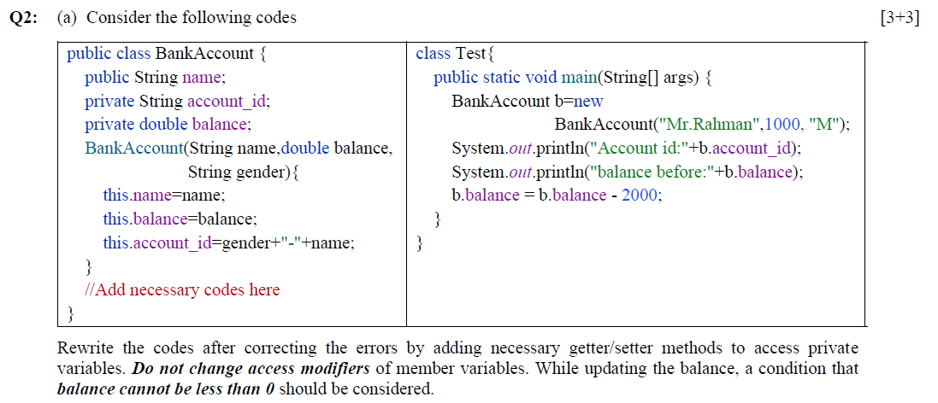
Fall 2023 Question 2

Slide 45
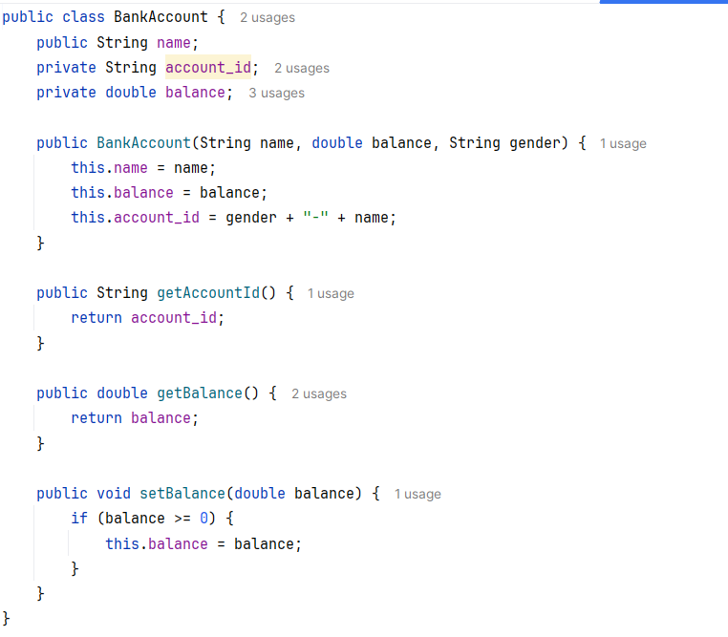
Fall 2023 Question 2

Slide 46
Static and Final

Slide 47
Static Variables
When a member (both methods and variables) is declared static, it can be accessed before any objects of its class are created, and without reference to any object.
Static variable
Instance variables declared as static are like global variables.
When objects of its class are declared, no copy of a static variable is made.

Slide 48
Static Methods & Blocks
Static method
They can only call other static methods.
They must only access static data.
They cannot refer to this or super in anyway.
Static block
Initialize static variables.
Get executed exactly once, when the class is first loaded.

Slide 49
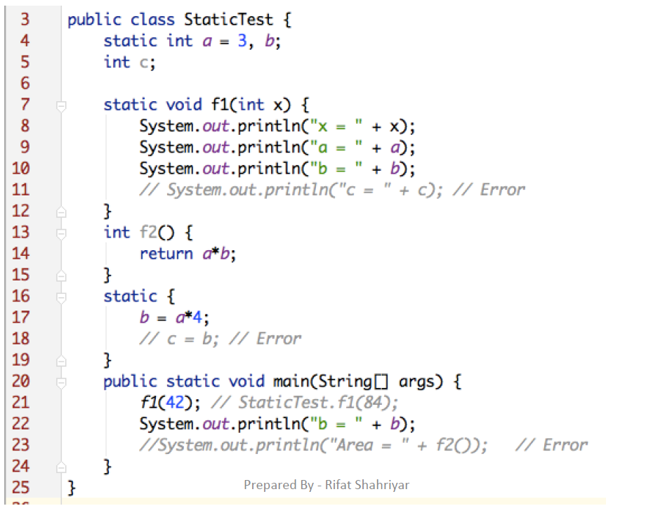
Example

Slide 50
Final
Declare a final variable, prevents its contents from being modified.
Final variable must initialize when it is declared.
It is common coding convention to choose all uppercase identifiers for final variables
final int FILE_NEW = 1;
final int FILE_OPEN = 2;
final int FILE_SAVE = 3;
final int FILE_SAVEAS = 4;
final int FILE_QUIT = 5;

Slide 51
SCOPE & LIFETIME OF VARIABLES

Slide 52
SCOPE OF VARIABLE
What is scope?
A scope determines what variable are visible to other parts of your program. Or where the variable is accessible?
It also determines the lifetime of those variable.
A block defines a scope.
the statements between opening and closing curly braces.
As a general rule, variables declared inside a scope are not visible (that is, accessible) to code that is defined outside that scope.
Within a block, variables can be declared at any point, but are valid only after they are declared.
Thus, if you define a variable at the start of a method, it is
available to all of the code within that method.
Conversely, if you declare a variable at the end of a block, it is effectively useless, because no code will have access to it.

Slide 53
SCOPE OF VARIABLE - EXAMPLE
public void calculateInterest(double balance)
{
if(balance > 10000)
{
float interest = 0.05f;
}
else
{
interest = 0.02f;
}
}

Slide 54
SCOPE OF VARIABLE - EXAMPLE
public void calculateInterest(double balance)
{
if(balance > 10000)
{
float interest = 0.05f; // Scope of this variable is only inside the if
block
}
else
{
interest = 0.02f; // compiler error. interest is declared inside the if block, hence can't access in else block
}
}
To make “interest” accessible to both if and else block it has to be declared outside of the block.

Slide 55
SCOPE OF VARIABLE - EXAMPLE
public void calculateInterest(double balance)
{
float interest; // accessible to anywhere inside the method. if(balance > 10000)
{
interest = 0.05f; // Ok
}
else
{
interest = 0.02f; // OK
}
}

Slide 56
SCOPE OF VARIABLE
Many other computer languages define two general
categories of scopes:
global and local.
However, these traditional scopes do not fit well with
Java’s strict, object-oriented model.
In Java, the two major scopes are
those defined by a class and
those defined by a method.

Slide 57
WHEN CAN 2 VARIABLES HAVE SAME
NAME
Instance variable and Local variable.
Local variable in 2 different methods.
2 Local variables in the same methods but only after the death of one Local variable.
OK | Wrong
public void calculateInterest(double balance) { if(balance > 10000){ float interest = 0.05f; // OK } else { float interest = 0.02f; // OK } } | public void calculateInterest(double balance) { float interest; if(balance > 10000){ float interest = 0.05f; // Compiler error } else { interest = 0.02f; // OK } }

Slide 58
ARRAYS

Slide 59
ARRAY AGAIN
What is the “new” keyword during array creation.
Is Array variable reference type?
int[] sampleArray = new int[10];

Slide 60
ARRAY AGAIN
What is the “new” keyword during array creation.
Is Array variable reference type?
int[] sampleArray = new int[10];
0
0
0
0
0
0
0
0
0
0
0
1
simpleArray
reference
8
9

Slide 61
ARRAY AGAIN
When an array is created, each element will be
initialized to its default value.
What is the initial value for each of the element of the arrays below.
int[] sampleArray = new int[10];
Student[] students = new Student[10];

Slide 62
REFERENCE TYPE WITH NOT NULL
Student student = new Student(“Rashid”, “011153001”, 3.0f, 50);
name = Rashid id = 011153001
cgpa= 3.0f
creaditCompleted = 50
student
reference
What value will you get when you access the following
attributes of student reference variable/object.
student.name
student.id
student.cgpa
student.creditCompleted

Slide 63
REFERENCE TYPE WITH NULL
Student student = null;
student
null
What value will you get when you access the following attributes of student reference variable/object.
student.name
student.id
student.cgpa
student.creditCompleted

Slide 64
REFERENCE TYPE WITH NULL
We cant access any member via the reference
variable when no object is created.
Accessing the member will throw NullPointerException.

Slide 65
REFERENCE TYPE ARRAY
Example
Student[] students = new Student[3];
System.out.println(students[0].cgpa); // What would be the output of this line.
null
null
null
students
reference

Slide 66
REFERENCE TYPE ARRAY
Need to initialize the element before accessing.
Example
Student[] students = new Student[3];
students[0] = new Student(“Rashid”, “011153001”, 3.0f, 50); students[1] = new Student(“Zaman”, “011153021”, 3.0f, 50); students[2] = new Student(“Lubna”, “011153031”, 3.5f, 50);
System.out.println(students[0].cgpa); // What would be the output of this line.
name = Rashid id = 011153001
cgpa= 3.0f creaditCompleted = 50
Ref
Ref
Ref
name = Zaman id = 011153021
cgpa= 3.0f
creaditCompleted = 50
students
reference
name = Lubna id = 011153031
cgpa= 3.5f creaditCompleted = 50

Slide 67
PARAMETER PASSING

Slide 68
PARAMETER PASSING
2 different ways
Pass By Value
Pass By Reference
In Java all parameters are passed by value

Slide 69
PASS BY REFERENCE – NOT APPLICABLE
FOR JAVA
Send the location of the parameter.
Original value chage
C, C++, php
main() {
int i = 10, j = 20;
cout << i << " " << j << endl; swapThemByRef(i, j);
cout << i << " " << j << endl; // displays 20 10 ...
}
void swapThemByRef(int& num1, int& num2) { int temp = num1;
num1 = num2;
num2 = temp;
}

Slide 70
PASS BY REFERENCE – NOT APPLICABLE
FOR JAVA
Send the location of the parameter.
Original value chage
C, C++, php
main() {
int i = 10, j = 20;
cout << i << " " << j << endl; swapThemByRef(i, j);
cout << i << " " << j << endl; // displays 20 10 ...
}
void swapThemByRef(int& num1, int& num2) { int temp = num1;
num1 = num2;
num2 = temp;
}
Output:
10 20
20 10

Slide 71
PASS BY REFERENCE
At the beginning of function call
i j
10
20
num1
num2
temp
After the function execution.
i j
20
10
num1
num2
10
temp

Slide 72
PASS BY VALUE
Send a copy of the original parameter.
Original value does not change
Example:
main() {
int i = 10, j = 20;
cout << i << " " << j << endl; swapThemByVal(i, j);
cout << i << " " << j << endl;
}
void swapThemByVal(int num1, int num2) { int temp = num1;
num1 = num2;
num2 = temp;
}

Slide 73
PASS BY VALUE
Send a copy of the original parameter.
Original value does not change
Example:
main() {
int i = 10, j = 20;
cout << i << " " << j << endl; swapThemByVal(i, j);
cout << i << " " << j << endl; // displays 20 10 ...
}
void swapThemByVal(int num1, int num2) { int temp = num1;
num1 = num2;
num2 = temp;
}
Output:
10 20
10 20

Slide 74
PASS BY VALUE
At the beginning of method call
i j
10
20
num1
10
20
num2
temp
After the method execution.
i j
10
20
num1
20
10
num2
10
temp

Slide 75
PASS BY VALUE
Java Example:
public class PassByValue {
public static void main(String[] args) {
int a=10, b=20;
System.out.printf("a-%d:b-%d\n", a, b); swapThemByVal(a, b); System.out.printf("a-%d:b-%d\n", a, b);
}
Output:
a-10:b-20
a-10:b-20
static void swapThemByVal(int num1, int num2) { int temp = num1;
num1 = num2; num2 = temp;
}
}

Slide 76
PASS BY VALUE
At the beginning of method call
i j
10
20
num1
10
20
num2
temp
After the method execution.
i j
10
20
num1
20
10
num2
10
temp

Slide 77
PASS BY VALUE – WITH OBJECT
When an object is passed to a method, the
situation changes dramatically,
Java will pass by value but the effect will be like pass-by-reference.
Why?
When we create a variable of a class type, it will store the reference to an object.
Thus, when the value of the variable will be passed to a method, it will pass the reference of the same object.
This effectively means that objects act as if they are
passed to methods by use of pass-by-reference.
Changes to the object inside the method do affect the object used as an argument.

Slide 78
PASS BY VALUE – WITH OBJECT
public class Test{ String testName; float score;
Test(String n, float s){ testName = n; score = s;
}
void display(){
System.out.printf("TestName: %s ; Score: %.2f\n", testName, score);
}
}

Slide 79
PASS BY VALUE – WITH OBJECT
public class PassByValue {
public static void main(String[] args) { Test t = new Test("CT1", 10); t.display();
updateScore(t, 15.0f); System.out.println("After Update:"); t.display();
}
static void updateScore(Test test, float newScore) { test.score = newScore;
}
}
Output:
TestName: CT1 ; Score: 10.00
After Update:
TestName: CT1 ; Score: 15.00

Slide 80
PASS BY VALUE – WITH OBJECT
Before the method call
t
Object
reference
testName= “CT1” score = 10.0f;
At the beginning of method call
Both “t” and “test” are referring to the same object.
Updating the object using any variable will be reflected in the other one.
t
reference
testName= “CT1” score = 10.0f;
test
reference
Just at the end of method execution – before exiting the method
t
reference
testName= “CT1”
score = 15.0f;
test
reference

Slide 81
GARBAGE COLLECTION

Slide 82
GARBAGE COLLECTION
when no references to an object exist, that object is assumed to be no longer needed, and the memory occupied by the object can be reclaimed.
Garbage collection only occurs sporadically (if at all) during the execution of your program.
Different Java run-time implementations will take varying approaches to garbage collection,
but for the most part, you should not have to think about it while writing your programs.

Slide 83
GARBAGE COLLECTION – SCENARIO#1
BankAccount accountR = new BankAccount(“Rashid”, “1000500” , 1000.0);
BankAccount accountK = new BankAccount((“Kashem”, “1000501” , 10000.0);
Heap
Stack
name = Rashid
id = 1000500
balance = 1000.0
accountR
reference
accountK
reference
name = Kashem
id = 1000501
balance = 10000.0

Slide 84
GARBAGE COLLECTION – SCENARIO#1
BankAccount accountR = new BankAccount(“Rashid”, “1000500” , 1000.0); BankAccount accountK = new BankAccount((“Kashem”, “1000501” , 10000.0); accountR = accountK;
// Rashid’s object can no longer be accessed and is eligible for garbage collection
Heap
Stack
name = Rashid
id = 1000500
balance = 1000.0
accountR
reference
accountK
reference
name = Kashem
id = 1000501
balance = 10000.0

Slide 85
GARBAGE COLLECTION – SCENARIO#2
BankAccount accountR = new BankAccount(“Rashid”, “1000500” , 1000.0);
BankAccount accountK = new BankAccount((“Kashem”, “1000501” , 10000.0);
Heap
Stack
name = Rashid
id = 1000500
balance = 1000.0
accountR
reference
accountK
reference
name = Kashem
id = 1000501
balance = 10000.0

Slide 86
GARBAGE COLLECTION – SCENARIO#2
BankAccount accountR = new BankAccount(“Rashid”, “1000500” , 1000.0); BankAccount accountK = new BankAccount((“Kashem”, “1000501” , 10000.0); accountR = null;
// Rashid’s object can no longer be accessed and is eligible for garbage collection
Heap
Stack
name = Rashid
id = 1000500
balance = 1000.0
accountR
null
accountK
reference
name = Kashem
id = 1000501
balance = 10000.0

Slide 87
GARBAGE COLLECTION – SCENARIO#3
public class TestMain{
public static void main(String[] args) {
updateScore(new Test("CT1", 10), 15.0f);
}
static void updateScore(Test test, float newScore) { test.score = newScore;
}
}
public class Test{ String testName; float score;
Test(String n, float s){ testName = n; score = s;
}
}

Slide 88
GARBAGE COLLECTION – SCENARIO#3
At the beginning of method call
testName= “CT1” score = 10.0f;
Heap
test
reference
After exiting the method.
“test” variable will no longer be available.
The Test object can no longer be accessed and is eligible for
garbage collection
testName= “CT1” score = 15.0f;
Heap

Slide 89
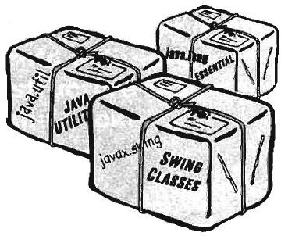
PACKAGE

Slide 90
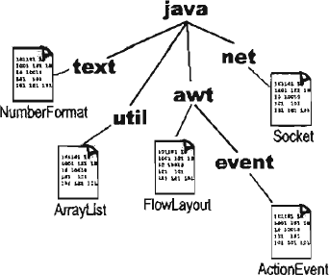
WHAT IS PACKAGE?
Packages are used to group related classes.
A package is a namespace that organizes a set of related classes and interfaces.
Conceptually you can think of packages as being similar to different folders on your computer.

Slide 91
WHAT IS PACKAGE?
Classes in same package can not have duplicate
name.
Classes in different packages can have the same name.
Class1
Package2
Class2
Package2_2
Class1
Package1
Class1
Package3
Class1
Not Allowed

Slide 92
WHAT IS PACKAGE?
Classes in same package can not have duplicate
name.
Classes in different packages can have the same name.
Class1
Package2
Class2
Package2_2
Class1
Package1
Class1
Package3
Class3

Slide 93
WHAT IS PACKAGE?
Classes in same package can not have duplicate
name.
Classes in different packages can have the same name.
Class1
Package2
Class2
Package2_2
Class1
Package1
Class1
Package3
Class3

Slide 94
HOW TO CREATE PACKAGE?
To create a package is quite easy:
simply include a package command as the first statement in a Java source file.
package pkg;
Any classes declared within that file will belong to the specified package.
Java uses file system directories to store
packages.
You can create a hierarchy of packages.
Use period/dot to separate each package name from
the one above it.
package pkg1.pkg2.pkg3;

Slide 95
PACKAGE -EXAMPLE
Example:
package uiu.cse; public class Test{
public void display() {
System.out.println( "Hello for Test class." );
}
}
The class must be in a file named “Test.java"
Place the file “Test.java" in a directory called “cse"
Place directory “cse" in a directory called “uiu”.
The directory “cse" can be placed anywhere, but you need to set the classpath.

Slide 96
PACKAGE -EXAMPLE
If you use IDE,
1-3 will be done automatically and “cse” will be placed under the “src” folder.
If no package is specified the file will be placed in a default package which maps to “src” folder

Slide 97
BENEFITS OF USING PACKAGE
The package is both a naming and a visibility control mechanism.
Packages are important for three main reasons.
First, they help the overall organization of a project or library.
Can organize code in a logical manner
makes large software projects easier to manage

Slide 98
BENEFITS OF USING PACKAGE
Second, packages give you a name scoping, to
help prevent collisions.
What will happen if you and 12 other programmers in your company all decide to make a class with the same name.
Third, packages provide a level of security,
Can define classes inside a package that are not
accessible by code outside that package.
can also define class members that are exposed only
to other members of the same package.

Slide 99
CLASS’S FULL NAME
A class has a full name, which is a combination of
the package name and the class name.
Class1
Full Name: Pack1.Pack2.Class1
Pack2
Class2
Pack1
Pack2_2
Class1
Full Name: Pack1.Pack2.Pack2_2.Class1
Class1
Pack3
Class3
Full Name: Pack1.Pack3.Class3

Slide 100
HOW TO ACCESS CLASS
To use a class in same package, you can use the
class name (short name).
To use a class in a different package, you must tell Java the full name of the class.
You use either an Import statement at the top of your source code, and use short name or
you can type the full name every place you use the
class in your code.
java.lang.* package is always implicitly get imported by Java. [ explicit import is not needed for this package]

Slide 101
CLASS IN SAME PACKAGE
Test Class
package uiu.cse; public class Test{
public void display() {
System.out.println( "Hello for Test class." );
}
}
Main Class
package uiu.cse;
public class TestMain {
public static void main(String[] args) { Test test = new Test(); test.display();
}
}

Slide 102
CLASS IN DIFFERENT PACKAGE – FULL NAME
Test Class
package uiu.cse; public class Test{
public void display() {
System.out.println( "Hello for Test class." );
}
}
Main Class
package uiu.cse.test; // any package other than uiu.cse
public class TestMain {
public static void main(String[] args) {
uiu.cse.Test test = new uiu.cse.Test(); // use Full name
test.display();
}
}

Slide 103
CLASS IN DIFFERENT PACKAGE - IMPORT
Test Class
package uiu.cse; public class Test{
public void display() {
System.out.println( "Hello for Test class." );
}
}
Main Class
import uiu.cse.Test; // Need to import the class. public class TestMain {
public static void main(String[] args) { Test test = new Test(); // use Short name test.display();
}
}
To import all classes under a package we need to use *
after the package name. Example:
import uiu.cse.*;

Slide 104
ACCESS CONTROL/ACCESS MODIFIER
How a member can be accessed is determined by
the access modifier attached to its declaration.
4 types
public
Protected
Default/Package Access – No modifier
Private
Outer class can only be declared as public or
default.

Slide 105
PRIVATE
Members declared private are accessible only in
the class itself
Example:
class Private {
private String name = "Private";
public void print() { System.out.println( name );
}
}
class PrivateExample {
public static void main( String[] args ) { Private pr = new Private(); pr.print(); // OK
System.out.println( pr.name ); // Compile error
}
}

Slide 106
DEFAULT/PACKAGE ACCESS
When no access modifier is specified
Accessible in the package that contains the class
Not accessible outside the package that contains the class.
Not even child class.

Slide 107
DEFAULT/PACKAGE ACCESS - EXAMPLE
Class that will be accessed from other classes
package test; class Default{
String name = “Default“;
}
Class under different package
package test1;
class DefaultExample {
public static void main( String[] args ) { Default dfl= new Default();
System.out.println( dfl.name ); // Compile error
}
}
Class under same package
package test;
class DefaultExample1 {
public static void main( String[] args ) { Default dfl = new Default(); System.out.println( dfl.name ); // OK
}
}

Slide 108
DEFAULT/PACKAGE ACCESS - EXAMPLE
Child Class under different package
package test1;
class DefaultChild extends Default { public DefaultChild() {
name = “Child”; // Compile error
}
}
Child Class under same package
package test;
class DefaultChild1 extends Default { public DefaultChild1() {
name = “Child”; // OK
}
}

Slide 109
PROTECTED
Members declared protected are directly
accessible to any subclasses,
Even if the child is in different package
directly accessible by code in the same package.

Slide 110
PROTECTED - EXAMPLE
Class that will be accessed from other classes
package test; class Protected {
protected String name = "Protected“;
}
Class Under Different Package
package test1;
class ProtectedExample {
public static void main( String[] args ) { Protected pr = new Protected();
System.out.println( pr.name ); // Compile error
}}
Class Under Same Package
package test;
class ProtectedExample1 {
public static void main( String[] args ) { Protected pr = new Protected(); System.out.println( pr.name ); // OK
}}

Slide 111
PROTECTED - EXAMPLE
Child Class Under Different Package
package test1;
class ProtectedChild extends Protected { public ProtectedChild() {
pr.name = “Child”; // OK
}
}
Child Class Under Same Package
package test;
class ProtectedChild1 extends Protected { public ProtectedChild1() {
pr.name = “Child”; // OK
}
}

Slide 112
PUBLIC
Members declared public are accessible anywhere
the class is accessible
All the scenario described in other 3 types of access modifier won’t give any compile error

Slide 113
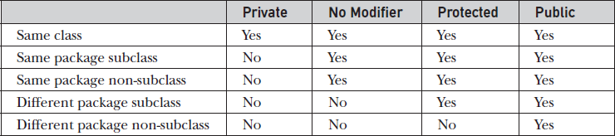
ACCESS MODIFIER CHART

Slide 114
RECURSION
It is the process of a method calling itself. A recursion has
two parts
stop condition
call itself
Recursion is an expensive procedure and it is better to
avoid recursion if you do not need.
Example: Factorial, Fibonacci
public class MyMathLibrary { public static int factorial(int n){
if (n <= 0)
return 1; // stop condition
return n * factorial(n-1); // call itself
}
public static void main( String[] args ){ System.out.print("Factorial of 5 is: " + factorial(5)); System.out.print("Factorial of 6 is: " + factorial(6));
}
}

Slide 115
VARIABLE ARGUMENT

Slide 116
VARIABLE ARGUMENT – OLD APPROACH
// Use an array to pass a variable number of arguments to a method.
// This is the old-style approach to variable-length arguments.
class PassArray {
static void vaTest(int v[]) {
System.out.print("Number of args: " + v.length + " Contents: ");
for(int x : v)
System.out.print(x + " "); System.out.println();
}
public static void main(String args[]) {
// Notice how an array must be created to hold the arguments.
int n1[] = { 10 };
int n2[] = { 1, 2, 3 };
int n3[] = { }; vaTest(n1); // 1 arg vaTest(n2); // 3 args vaTest(n3); // no args
Output:
Number of args: 1 Contents: 10
Number of args: 3 Contents: 1 2 3 Number of args: 0 Contents:
}
}

Slide 117
VARIABLE ARGUMENT – NEW APPROACH
Introduced in Java 5.
Can pass variable number of argument.
This feature is called varargs - short for
variable-length arguments.
A method that takes a variable number of arguments is called a variable-arity method, or simply a varargs method.
A variable-length argument is specified by three periods (…).
Example : static void vaTest(int ... v) {
The argument v act as an array

Slide 118
VARARG - EXAMPLE
// Demonstrate variable-length arguments. class VarArgs {
// vaTest() now uses a vararg. static void vaTest(int ... v) {
System.out.print("Number of args: " + v.length + " Contents: "); for(int x : v)
System.out.print(x + " "); System.out.println();
}
public static void main(String args[]) {
// Notice how vaTest() can be called with a
// variable number of arguments. vaTest(10); // 1 arg
vaTest(1, 2, 3); // 3 args vaTest(); // no args
}
}
Output: Same as before

Slide 119
VARIABLE ARGUMENT
A method can have “normal” parameters along with
a variable-length parameter.
However, the variable-length parameter must be the last parameter declared by the method.
For example,
Following method declaration is perfectly acceptable:
int doIt(int a, int b, double c, int ... vals) {
Inacceptable method
int doIt(int a, int b, double c, int ... vals, boolean stopFlag) { // Error!
Can’t have more than one vararg parameter
int doIt(int a, int b, double c, int ... vals, double ... morevals) { // Error!

Slide 120
REFERENCE
Java:Complete Reference Chapter 6,7,9

